Slide 1
LuNaVision AI:
An Intelligent Multi-Agent Pipeline for Automated Exoplanet Discovery from TESS Observations
Artificial Intelligence & Data Science • Astronomical Signal Processing • Multi-Agent Systems
PROJECT GUIDE
Mrs. M. Bhavadharini
Dr. S. Sasikala
TEAM MEMBERS
B R Prasanna
M Sandeep
S Gokul
PROJECT PHASE 1 / AI&DS

Slide 2
ABSTRACT
Concept
Exoplanet discovery from TESS light-curve data is a fast-growing but data-intensive field — NASA's TESS mission produces far more stellar brightness data than can be reviewed manually.
Prior work applies ML/DL models (Random Forest, SVM, CNN, LSTM, Transformers) to detect transit signals and separate them from noise and false positives.
Existing System & Drawbacks
Existing approaches are typically built for a single stage of the detection process (e.g. classification only).
They require manual intervention for preprocessing, validation and interpretation.
No existing system offers a complete, automated end-to-end discovery pipeline.
Proposed System
LuNaVision AI — an intelligent multi-agent pipeline that automates the complete exoplanet detection workflow using specialized AI agents for acquisition, preprocessing, noise reduction, transit detection, classification, orbital parameter estimation, explainable decision-making and report generation.
Integrates Multi-Agent Systems, LLMs, Explainable AI (XAI), Machine Learning, Deep Learning and time-series analysis for a scalable, interpretable solution.
Aims to improve detection accuracy, reduce false positives, minimize manual effort and accelerate exoplanet discovery.
Key Highlights: 8 Specialized AI Agents | GPU-Accelerated Feature Engineering | Ensemble ML + Bayesian MCMC | Explainable & Human-in-the-Loop
PROJECT PHASE 1 / AI&DS
02

Slide 3
OBJECTIVES
To develop an AI-based multi-agent framework for automated exoplanet discovery.
To automate TESS data acquisition and preprocessing.
To reduce noise in stellar light curves.
To detect potential planetary transit signals.
To classify exoplanet candidates and false positives.
To estimate orbital parameters.
To provide Explainable AI (XAI) for decisions.
To generate automated scientific reports.
To reduce manual effort and improve scalability.
To leverage GPU acceleration for scalable, high-throughput feature extraction.
To incorporate human-in-the-loop active learning for continuous model improvement.
To design a modular, orchestrated multi-agent architecture that is easy to extend.
PROJECT PHASE 1 / AI&DS
03

Slide 4
SCOPE OF THE PROJECT
Benefits:
• Automates the exoplanet detection workflow.
• Reduces manual effort in data analysis.
• Reduces false positives during candidate identification.
• Handles large datasets efficiently.
• Improves interpretability using XAI.
• Generates automated scientific reports.
• Accelerates exoplanet discovery.
One-line Scope:
LuNaVision AI can be used as an intelligent assistance system for astronomers and space-research applications to automatically analyse TESS observations and identify potential exoplanet candidates.
Additional Capabilities:
• GPU-Accelerated Processing – Speeds up feature extraction for large-scale sector analysis.
• Human-in-the-Loop Active Learning – Continuously improves accuracy using expert feedback.
• Modular Multi-Agent Design – Easy to extend with new detection or analysis stages.
PROJECT PHASE 1 / AI&DS
04

Slide 5
EXISTING SYSTEM
A CNN-Based Ensemble Model for Exoplanet Detection
Existing Approach:
Uses stellar flux (light intensity) for exoplanet detection.
• Uses CNN-based ensemble learning for classification.
• The proposed Ensemble-CNN achieved 99.62% accuracy in the study.
Existing System Workflow:
Stellar Light Intensity → Data Processing → ML/DL Models → Ensemble-CNN → Exoplanet Classification
Limitations :
• Mainly focuses on exoplanet classification.
• Does not provide a complete automated end-to-end discovery pipeline.
• Does not cover all stages such as data acquisition, orbital parameter estimation, XAI and automated scientific reporting.
Problem :
Need for an automated, scalable, and interpretable end-to-end exoplanet discovery pipeline.
This gap directly motivates the multi-agent, end-to-end design of LuNaVision AI.
PROJECT PHASE 1 / AI&DS
05

Slide 6
PROPOSED SYSTEM
LuNaVision AI
An intelligent multi-agent pipeline that automates the complete exoplanet discovery workflow.
Workflow :
TESS Data
↓
Preprocessing & Noise Reduction
↓
Transit Detection
↓
Exoplanet Classification
↓
Orbital Parameter Estimation
↓
XAI Interpretation
↓
Scientific Report
Core Idea :
Each stage is handled by a dedicated AI agent and coordinated by a central Orchestrator Agent, enabling fully automated, end-to-end execution with no manual intervention.
PROJECT PHASE 1 / AI&DS
06

Slide 7
PROPOSED SYSTEM
Key Technologies :
Multi-Agent Systems
ML & Deep Learning
LLMs
XAI
Time-Series Analysis
Bayesian Inference (MCMC)
GPU Computing (CuPy / PyTorch)
Advantages :
End-to-end automation
Reduced manual effort
Fewer false positives
Scalable & interpretable
Continuous improvement via active learning
GPU-accelerated for large-scale data
PROJECT PHASE 1 / AI&DS
07

Slide 8
LITERATURE SURVEY
S.No | Title | Authors | Journal Name | Year | Methodology Used | Pros and Cons
1 | Exoplanet Imaging via Differentiable Rendering | Brandon Y. Feng, Rodrigo Ferrer-Chávez, Aviad Levis, William T. Freeman, Jason J. Wang | International Journal of Data Science and Analytics (Springer) | 2025 | Differentiable Rendering | Pros: Better contrast; improves faint-planet detection; uses wavefront data. Cons: High complexity; simulation-based; depends on wavefront data.
2 | Feature extraction for exoplanet detection | Pimentel J, Amorim J, Rudzicz | International Journal of Data Science and Analytics (Springer) | 2024 | Feature Extraction | Pros: Uses multiple feature domains; strong classification performance; reduces dataset bias through cross-validation. Cons: Depends on preprocessing; requires feature engineering; feature importance needs further analysis.
3 | Light intensity of stars for exoplanet detection | Jara-Maldonado, M. et al | IEEE Region 10 Symposium (TENSYMP) | 2022 | KNN + SMOTE | Pros: High accuracy; handles class imbalance; works with limited observations. Cons: Limited dataset; performance decreases with less data; mainly classification-focused.
4 | Identifying Exoplanets with Deep Learning IV: Removing stellar activity signals from RV data using neural networks | de Beurs Z.L. et al | The Astronomical Journal (IOP / AAS) | 2022 | Neural Networks + Linear Regression | Pros: Removes stellar activity signals; improves RV quality; validated with real observations. Cons: Requires spectral information; generalization needs further testing; RV-focused.
PROJECT PHASE 1 / AI&DS
08

Slide 9
LITERATURE SURVEY
S.No | Title | Authors | Journal Name | Year | Methodology Used | Pros and Cons
5 | A CNN-based ensemble model for exoplanet detection. | Priyadarshini I, Puri V | Earth Science Informatics (Springer) | 2021 | Ensemble-CNN | Pros: High detection accuracy; improves model performance; combines multiple models. Cons: Higher complexity; increased computational cost; mainly classification-focused.
6 | Scientific domain knowledge & deep learning | Ansdell, M. et al | The Astrophysical Journal Letters (IOP / AAS) | 2018 | Domain-Informed DL | Pros: Improves accuracy and recall; better detection of low-SNR transits; supports smaller models. Cons: Needs additional input data; requires centroid information; risk of overfitting.
7 | Discovering new worlds: signal processing methods for RV exoplanet detection. IEEE Signal Process | Khan, M.S., Jenkins, J., Yoma, N.B | IEEE Signal Processing Magazine (Vol. 34, pp.104–115) | 2017 | Signal Processing | Pros: Improves signal-to-noise ratio; provides statistical methods; useful for weak signals. Cons: Mainly RV-focused; relies on signal-processing techniques; not an automated AI pipeline.
8 | Exoplanet detection methods | Wright, J.T., Gaudi, B.S | Book chapter — Planets, Stars and Stellar Systems, Vol. 3 (Springer Netherlands); also on arXiv (2012) | 2012 | Detection Methods Review | Pros: Covers major detection methods; explains detection requirements; compares method sensitivity. Cons: Broad review; less focus on AI/ML; does not provide a new detection model.
PROJECT PHASE 1 / AI&DS
09

Slide 10
MODULES AND METHODOLOGIES
Modules :
Orchestrator Agent
→ Coordinates every stage and logs the full pipeline run.
Data Acquisition Agent
→ Downloads TESS FITS light curves and reference catalogs.
Preprocessing Agent
→ Cleans, normalizes and detrends every light curve.
Transit Detection Agent
→ Runs a BLS / TLS search to find repeating dip signals.
Feature Engineering Agent (GPU)
→ Extracts 35+ features using CuPy / PyTorch acceleration.
Classification Agent
→ Ensemble ML model assigns a calibrated planet probability.
Parameter Fitting Agent
→ Estimates orbital parameters via batman + emcee MCMC.
Active Learning Agent
→ Sends unsure candidates to a human and retrains on new labels.
Reporting Agent
→ Generates plots, the candidate catalog and the final report.
Methodology :
TESS Data → Acquire → Preprocess & Detrend → BLS/TLS Detect → GPU Feature Extraction → Ensemble Classify → MCMC Parameter Fit → Visualize & Report (Active Learning feeds unsure cases back into training)
PROJECT PHASE 1 / AI&DS
10

Slide 11
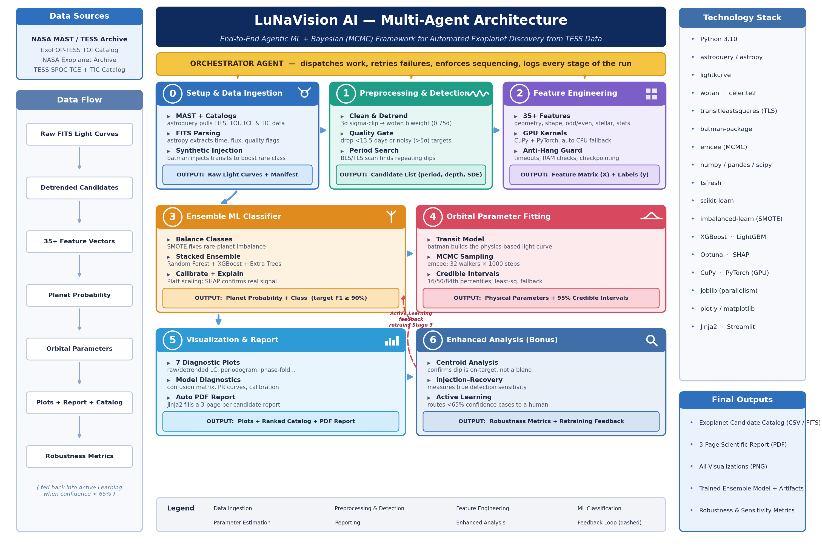
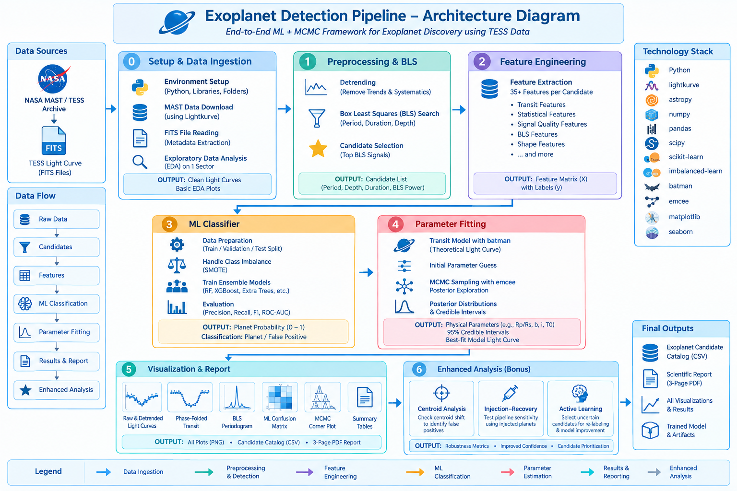
ARCHITECTURE DIAGRAM
PROJECT PHASE 1 / AI&DS
11

Slide 12
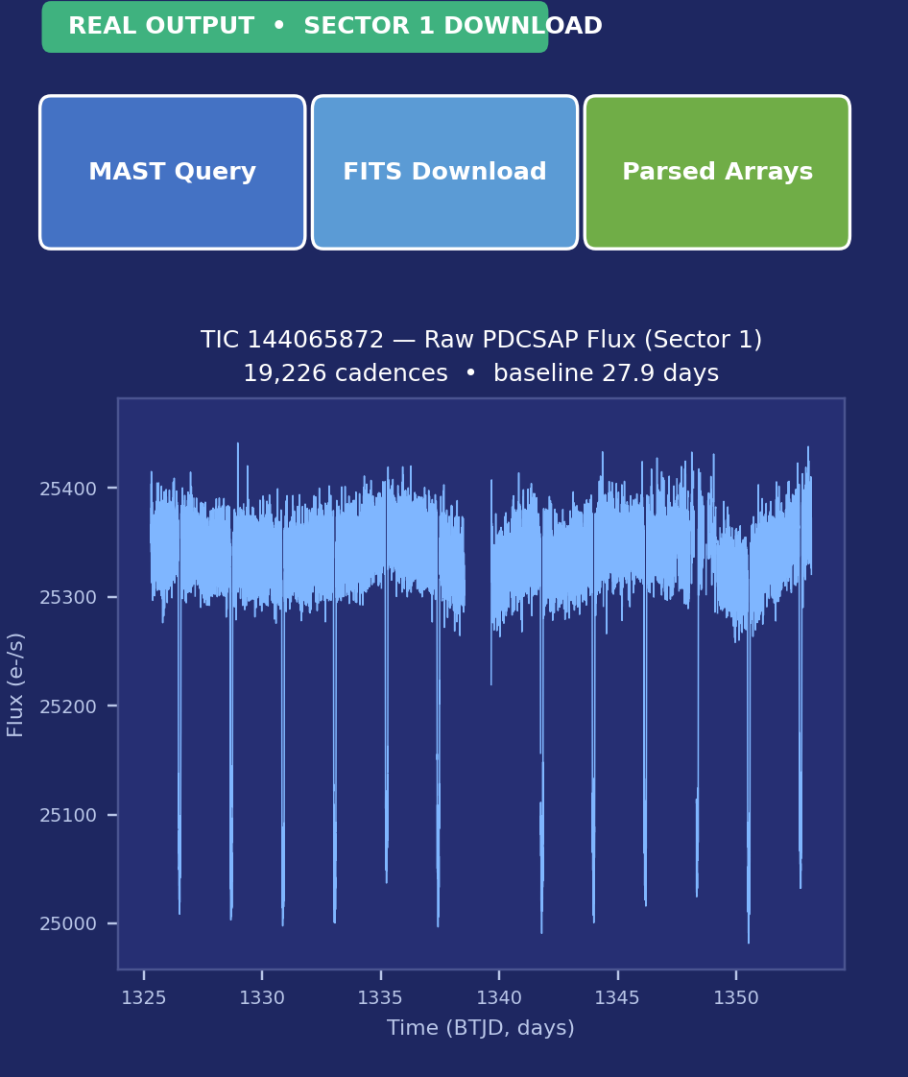
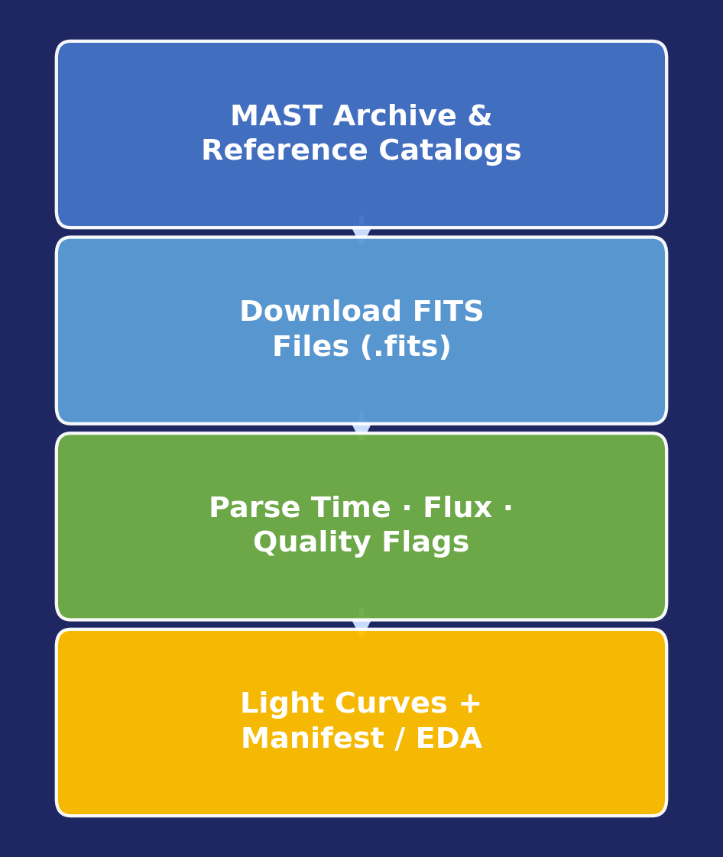
EXOPLANET DETECTION PIPELINE
Phase 0 — Data Acquisition & Setup
Status: COMPLETED — real Sector-1 data processed
Objective: Automatically fetch raw star-brightness data from NASA's TESS satellite and get it ready for analysis.
MAST Archive Queries — astroquery searches NASA's MAST archive for TESS light curves by sector, camera and CCD.
Reference Catalog Downloads — Auto-downloads and parses the ExoFOP TOI list, NASA Confirmed Planets table and the SPOC TCE catalog.
FITS Parsing — astropy reads each FITS file to pull out time, PDCSAP flux and data-quality flags.
Label Unification — Messy disposition codes (PC, KP, CP, EB, BEB, FP, V) are mapped into 4 clean classes.
Synthetic Transit Injection — batman injects artificial planet dips into quiet light curves to boost the rare Transit class.
Parallel, Resumable Downloads — A thread pool downloads many files at once and skips files already saved if a run is interrupted.
Output:
Raw TESS light-curve .npz files
Unified label catalog & TIC stellar parameters
Download manifest + initial EDA results
PROJECT PHASE 1 / AI&DS
12

Slide 13
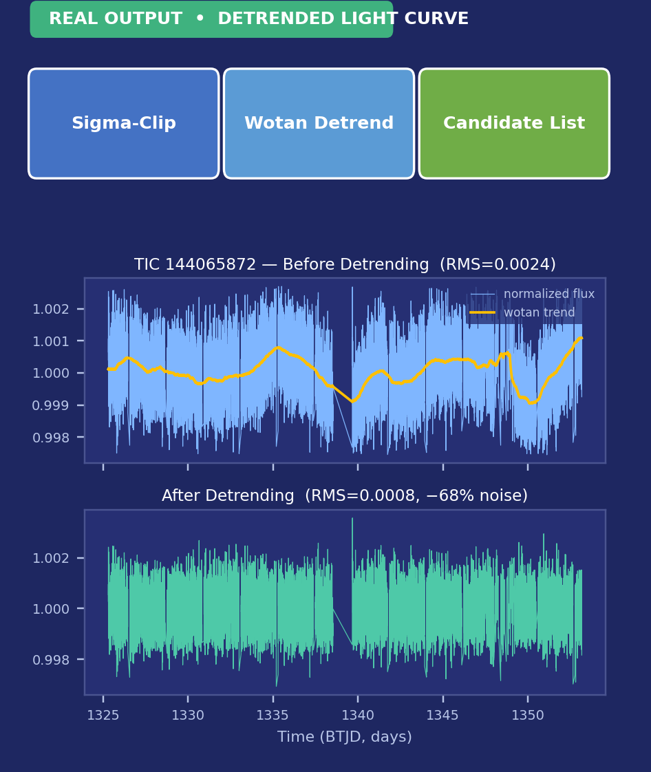
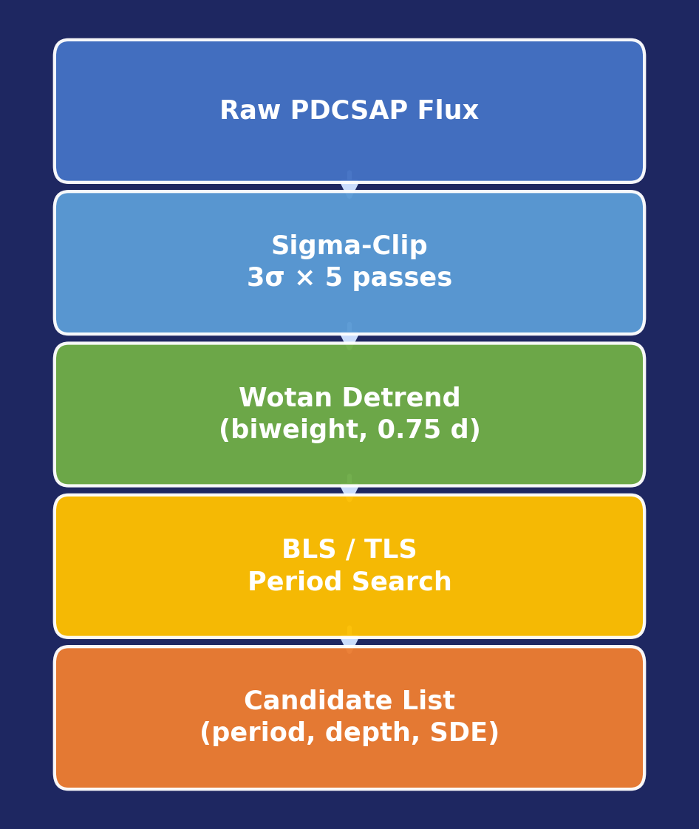
EXOPLANET DETECTION PIPELINE
Phase 1 — Preprocessing & Transit Search
Status: COMPLETED — real Sector-1 data processed
Objective: Clean up the noisy raw brightness readings and search for repeating dips that could be planets.
Normalization — Every light curve is divided by its median flux so all stars sit on the same brightness scale.
Outlier Removal — Iterative 3σ sigma-clipping, up to 5 passes, strips cosmic-ray hits and bad cadences.
Gap Handling — Small gaps (≤3 cadences) are filled by interpolation; longer gaps are flagged, not guessed.
Detrending — A wotan bi-weight filter (0.75-day window) removes slow drift while keeping the transit dip intact.
Quality Gating — Targets with <13.5 days of data, or noise >5× the expected photon noise, are dropped automatically.
BLS / TLS Search — A Box/Transit Least Squares scan tests thousands of trial periods to find the strongest repeating dip.
Output:
Cleaned & detrended light curves
Candidate list (period, depth, duration)
BLS / TLS parameters (SDE, FAP)
PROJECT PHASE 1 / AI&DS
13

Slide 14
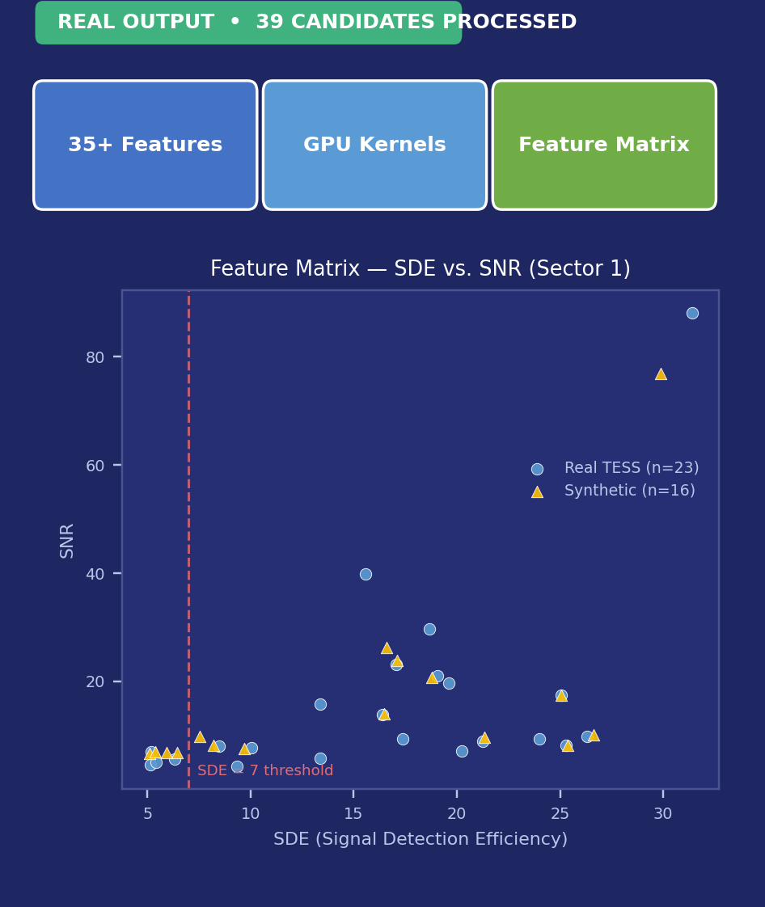
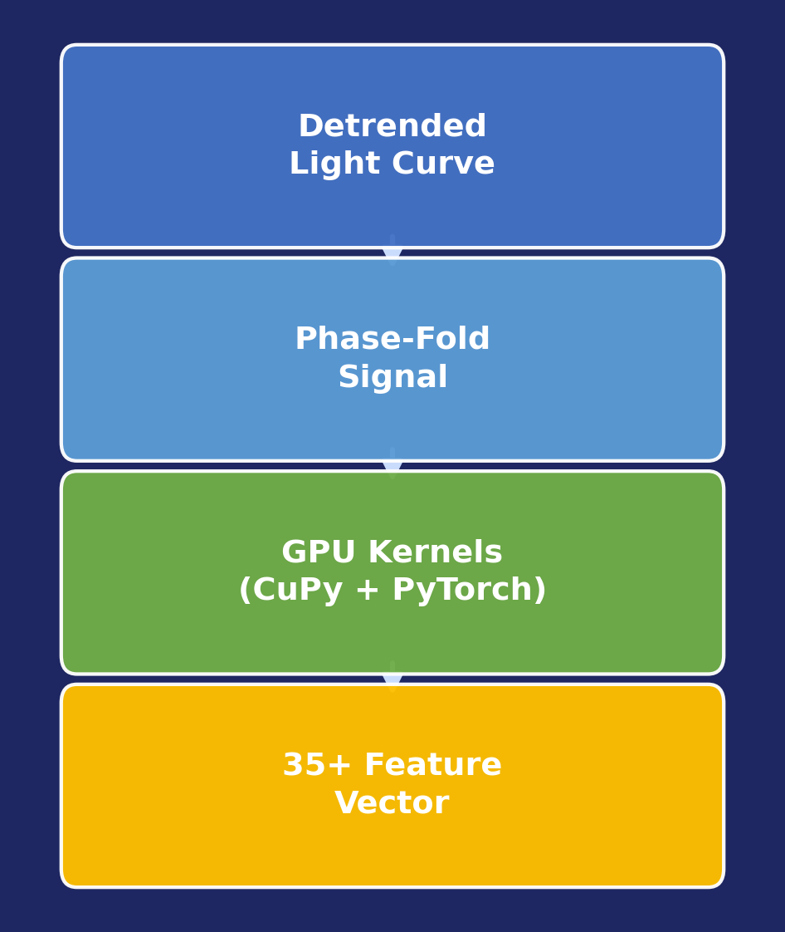
EXOPLANET DETECTION PIPELINE
Phase 2 — Feature Engineering (GPU-Accelerated)
Status: COMPLETED — real Sector-1 data processed
Objective: Turn each candidate signal into a set of numbers a machine-learning model can actually learn from.
35+ Engineered Features — Transit geometry, signal quality, shape, odd/even depth, secondary eclipse, centroid and stellar stats.
GPU Acceleration — Phase-folding, FFTs and statistics run on an NVIDIA GPU via CuPy and PyTorch, with automatic CPU fallback.
Anti-Hang Safeguards — Capped worker count, per-task timeouts and RAM monitoring stop one stuck light curve from freezing the run.
Batch Checkpointing — Progress saves every batch, so a long feature-extraction job can resume instead of restarting.
Stellar Cross-Match — Pulls Teff, log g, radius, mass and distance from the TIC catalog for astrophysical context.
Output:
feature_matrix.csv — one row per candidate
35+ columns, ready for machine learning
PROJECT PHASE 1 / AI&DS
14

Slide 15
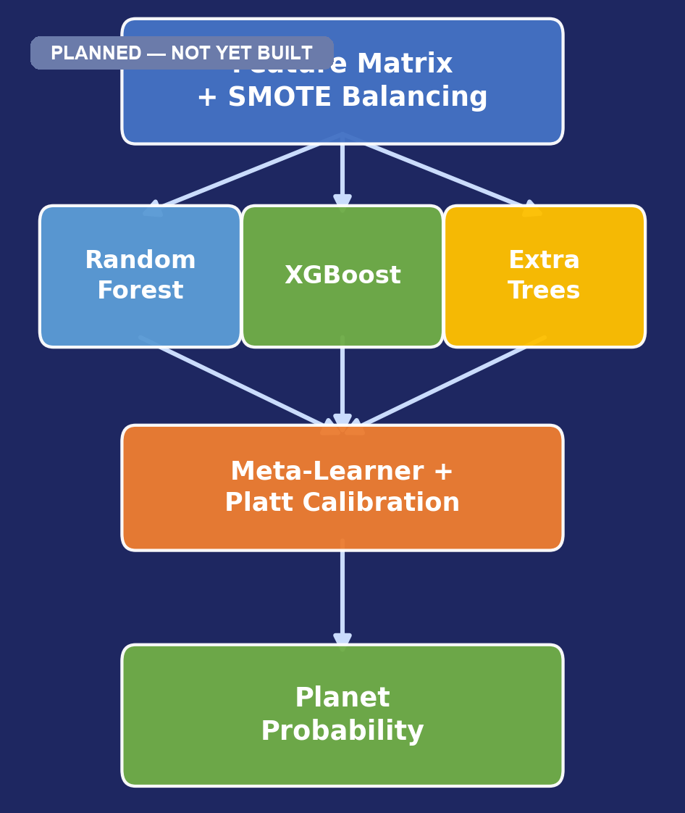
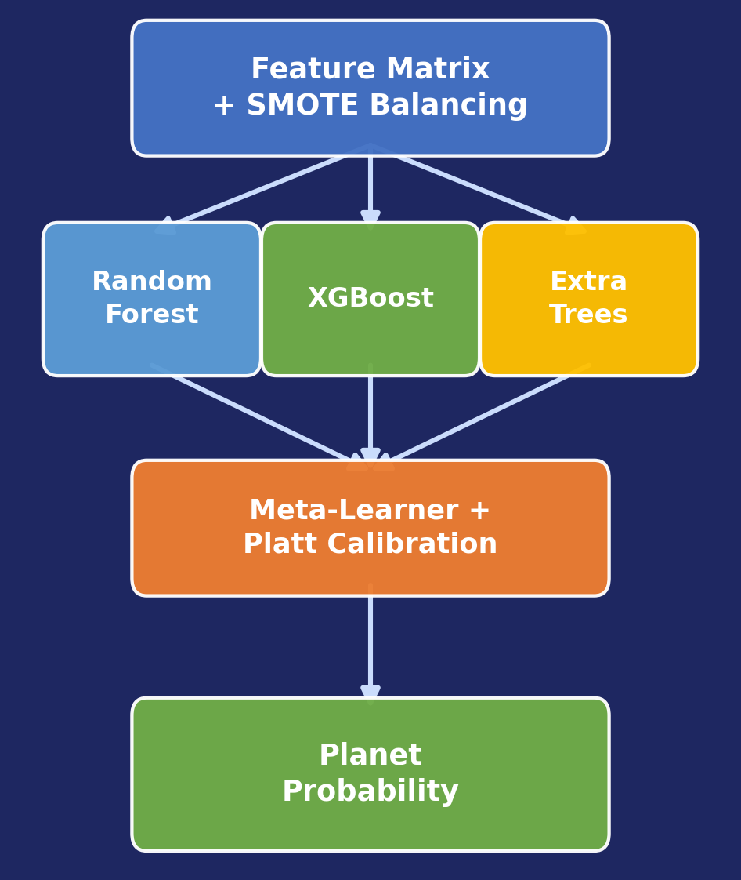
EXOPLANET DETECTION PIPELINE
Phase 3 — Ensemble Machine-Learning Classifier
Status: PLANNED — not yet implemented
Objective: Let the model decide, on its own, whether a candidate signal is really a planet or something else.
Class Balancing — SMOTE oversampling fixes the natural imbalance — real planets are rare next to false positives.
Ensemble Models — Random Forest, XGBoost and Extra Trees are trained together and combined via a stacked meta-learner.
Probability Calibration — Platt scaling makes predicted probabilities trustworthy — a "0.9" really means ~90% confident.
Explainability (SHAP) — SHAP values confirm the model relies on physically meaningful features like depth and SDE, not noise.
Confidence Routing — Predictions below 65% confidence are flagged for human review instead of being trusted blindly.
Target: macro F1-score ≥ 90% on held-out test data
Output:
Trained ML ensemble model
Calibrated planet probability per candidate
Planet / EB / Blend / Other class label
PROJECT PHASE 1 / AI&DS
15

Slide 16
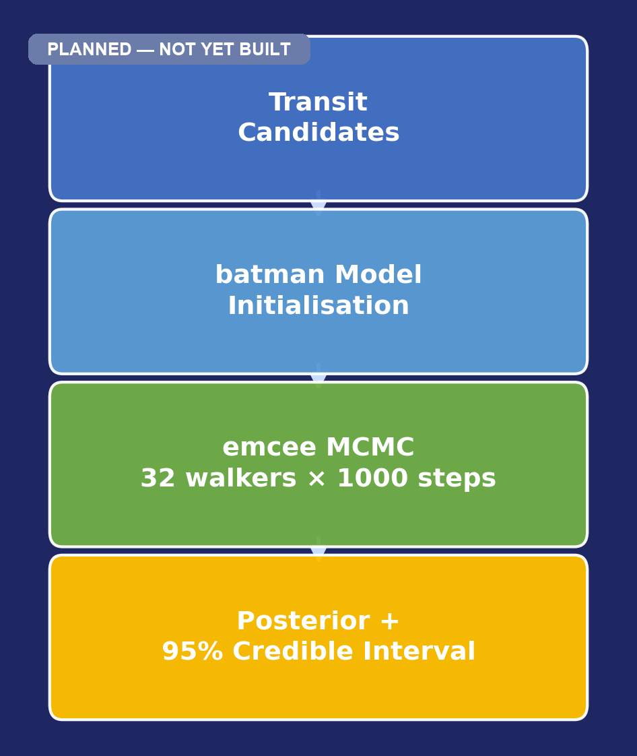
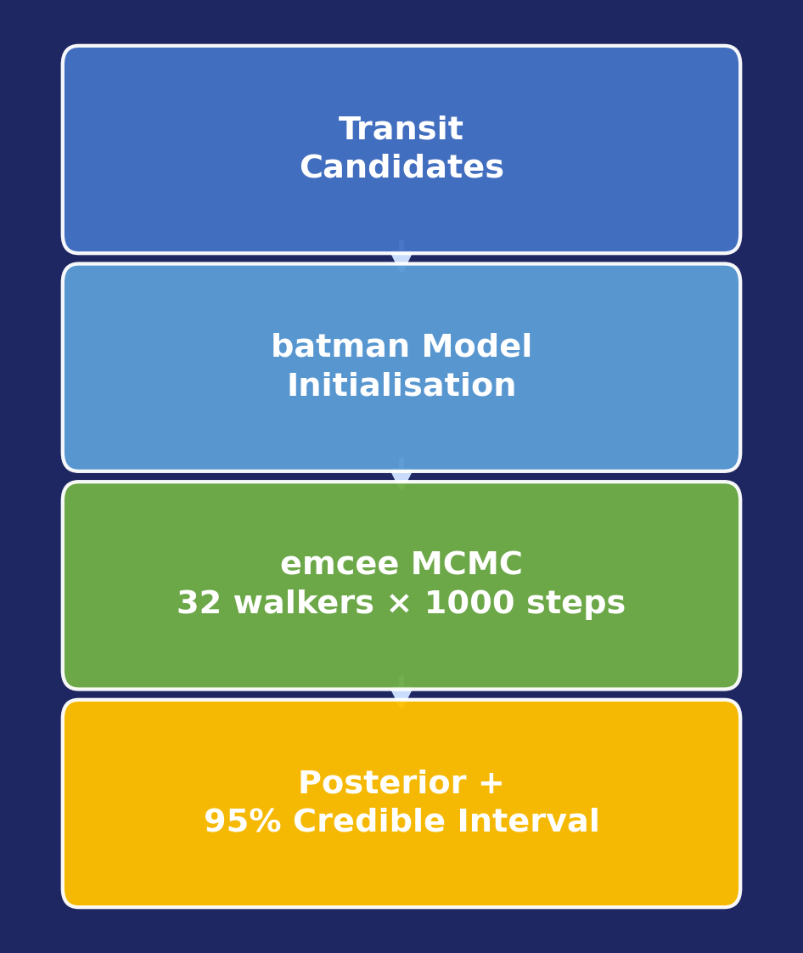
EXOPLANET DETECTION PIPELINE
Phase 4 — Orbital Parameter Fitting
Status: PLANNED — not yet implemented
Objective: For every strong candidate, work out its size, orbit and timing — with honest uncertainty ranges.
Transit Modeling — The batman package builds a physics-based model of the dip caused by a planet crossing its star.
Bayesian MCMC Fitting — emcee runs 32 walkers for 1000 steps to explore every plausible combination of parameters.
Parameters Estimated — Radius ratio (Rp/Rs), orbital period, impact parameter, inclination and transit midpoint.
Credible Intervals — 16th/50th/84th percentiles of the posterior give a 95% credible range, not just one number.
Fallback Handling — If MCMC fails to converge, the system falls back to a least-squares fit so it never gets stuck.
Output:
Best-fit transit model
Estimated planetary parameters
95% credible intervals per parameter
PROJECT PHASE 1 / AI&DS
16

Slide 17
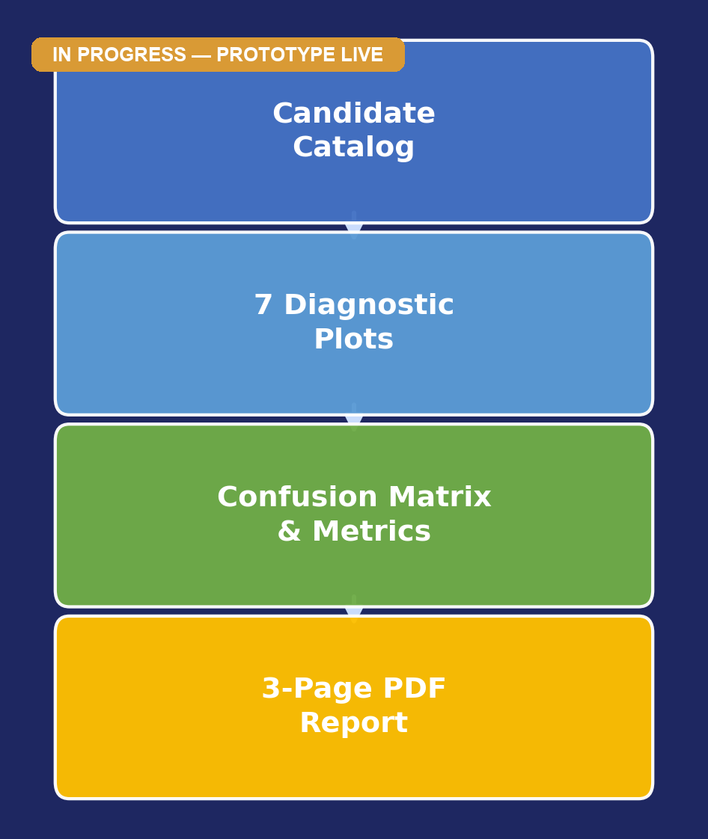
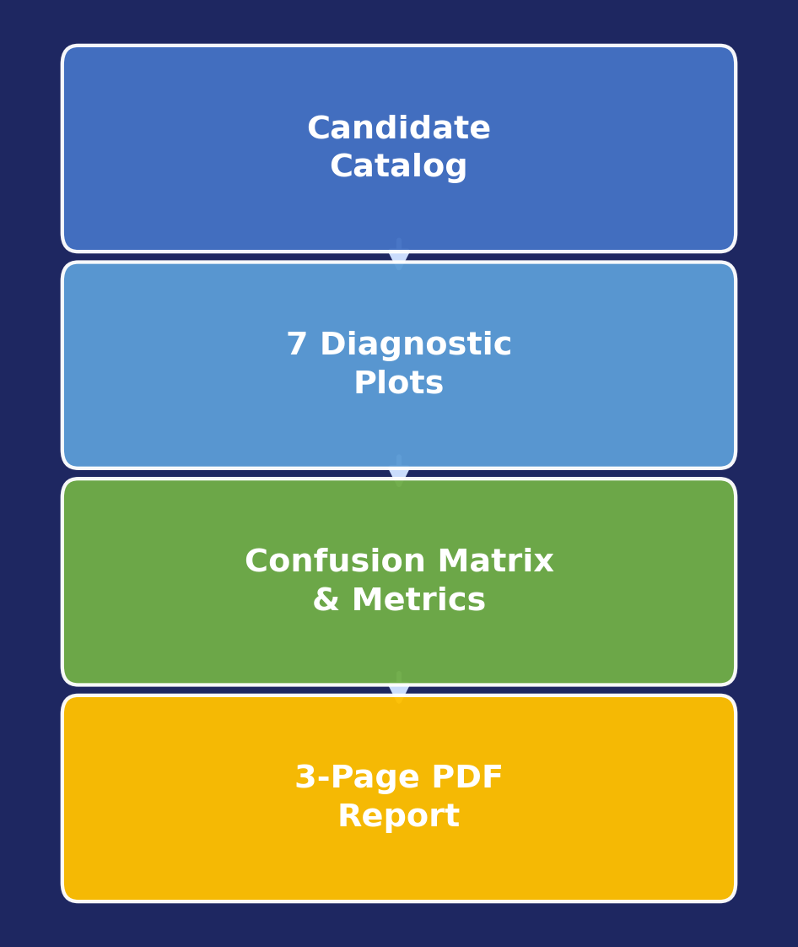
EXOPLANET DETECTION PIPELINE
Phase 5 — Visualization & Scientific Reporting
Status: IN PROGRESS — prototype dashboard live
Objective: Turn all the numbers into clear pictures and a short report a scientist can read in minutes.
7 Diagnostic Plots — Raw & detrended light curves, BLS/TLS periodogram, phase-fold + model, corner plot, odd/even, centroid.
Model Performance Views — Confusion matrix, precision-recall curves and calibration plots show how well the classifier performs.
Ranked Candidate Catalog — All candidates are sorted by signal-to-noise ratio into one master CSV / FITS table.
Automated PDF Report — A Jinja2 template auto-fills a 3-page report per candidate with plots, parameters and a verdict.
Output:
PNG / PDF visualizations
Candidate catalog (CSV / FITS)
3-page automated scientific report
PROJECT PHASE 1 / AI&DS
17

Slide 18
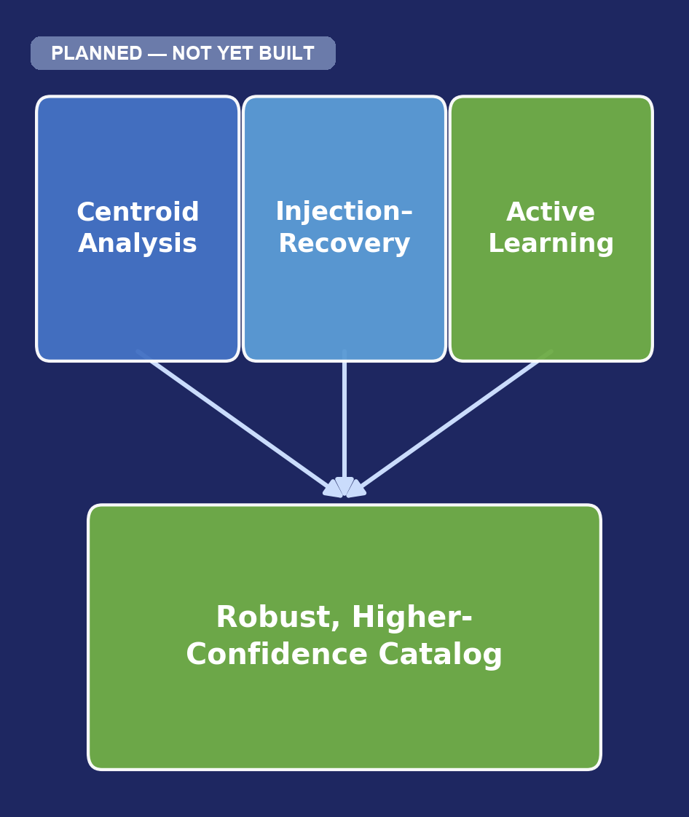
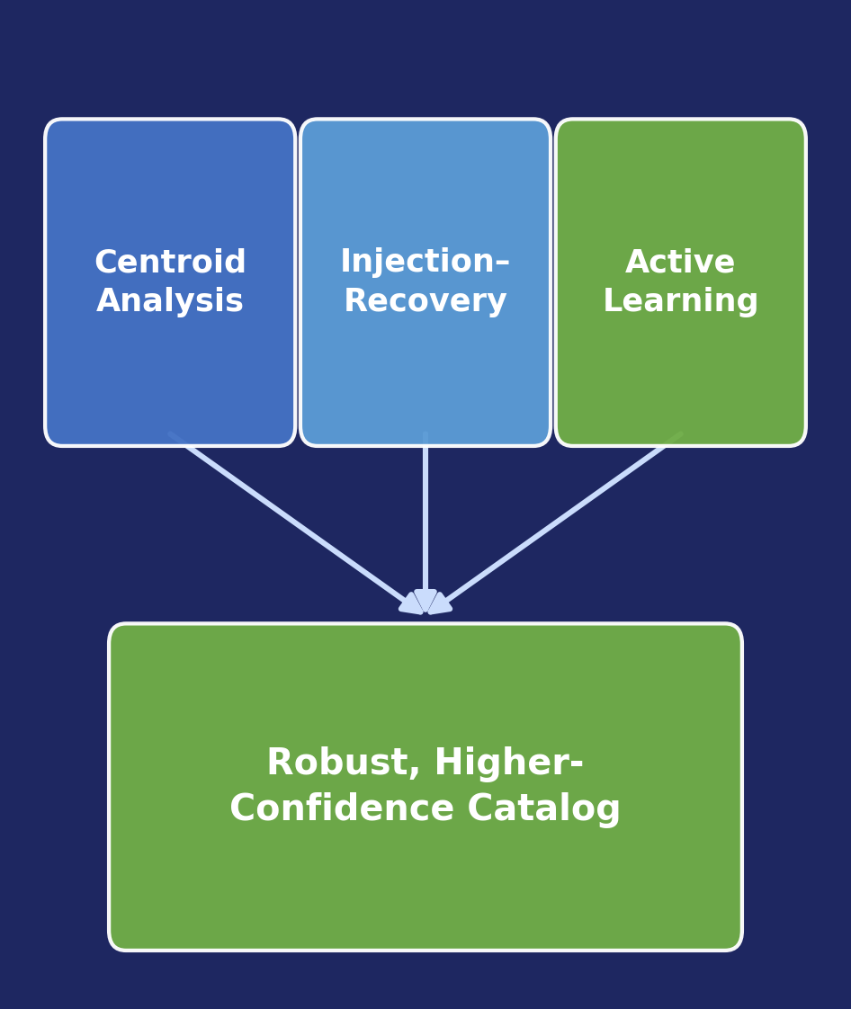
EXOPLANET DETECTION PIPELINE
Phase 6 — Enhanced Analysis & Reliability (Bonus)
Status: PLANNED — not yet implemented
Objective: Stress-test the pipeline itself so its results can actually be trusted.
Centroid Analysis — Checks the dip truly comes from the target star's own pixels and not a nearby contaminating star.
Injection–Recovery — Plants thousands of fake, exactly-known transits and reruns the pipeline to measure detection sensitivity.
Active Learning — Sends only the most uncertain (<65% confidence) candidates to a human, then retrains on the new labels.
Output:
Robustness & sensitivity metrics
Contamination-checked, higher-confidence candidates
A model that keeps improving with human feedback
PROJECT PHASE 1 / AI&DS
18

